Slide 1
A Comparison of Classification Techniques Applied to Handwritten Digit Recognition
Deric Pang (dericp), Saidutt Nimmagadda (nimmas)

Slide 2
Goal
Our project intended to implement and compare three different techniques – k-nearest neighbor regression, support vector machines, and convolutional neural networks – and their performance in classifying handwritten digits.

Slide 3
Dataset: MNIST pixel data
Training Set
60000 images represented as vectors.
Each vector has 1 label and 783 pixel features.
Final model built either from this set in its entirety, or from a subset of it depending on algorithm.
Test Set
10000 images represented as vectors.
Each vector has 1 label and 783 pixel features.
Data is normalized and digits are centered

Slide 4
Library Baselines
SciKit K-Nearest Neighbors
SciKit Support Vector Machine
Linear SVM
SVM with Radial Basis Function Kernel

Slide 5
Methods We Implemented From Scratch
K-Nearest Neighbors Regression using two classification methods
Classification based on the digit with the lowest average distance from the query point amongst the k nearest neighbors
Classification based on the Nadaraya Watson Gaussian Kernel Weighted Average
Support Vector Machine
PEGASOS: Primal Estimated sub-GrAdient SOlver for SVM
RBF Kernel Approximation with Random Fourier Features

Slide 6
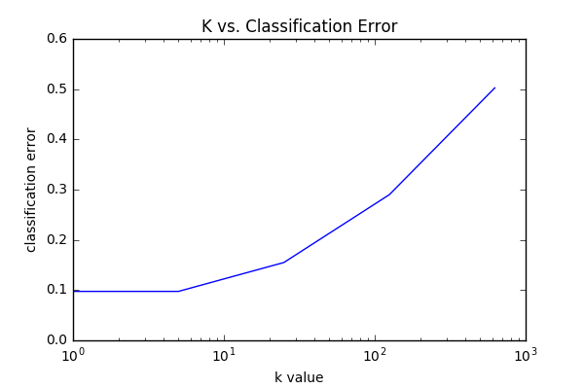
SciKit K-Nearest Neighbors
Conclusion: On the Baseline K-Nearest Neighbors algorithm, classification error was minimized when the point most similar to the query point was found and its classification was the query point’s classification (k = 1). We will use k = 1 when calculating our test error. When calculating our test error, we will use the entire training data set as the “model” for our test set.
Classification error calculated via cross validation, and found that a k of 1 was optimal.

Slide 7
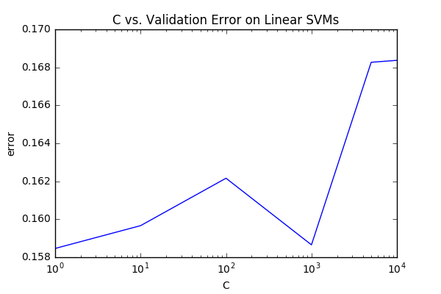
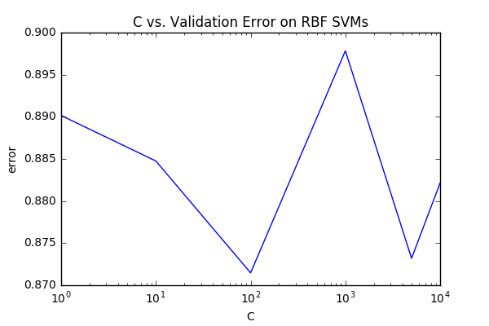
SciKit SVM
We found that the Linear SVM had a markedly lower validation error than the RBF SVM. We were surprised by this. The best C value, according to our cross-validation, was C = 1, but we're skeptical that variations in validation error are due to C value rather than variations in validation blocks because the differences in error are so small. Regardless, we'll build a Linear SVM model with C = 1 and an RBF SVM model with C = 100 with 20000 rows of our training set (for runtime purposes) and calculate test error.

Slide 8
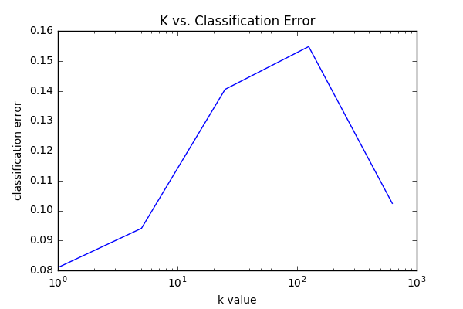
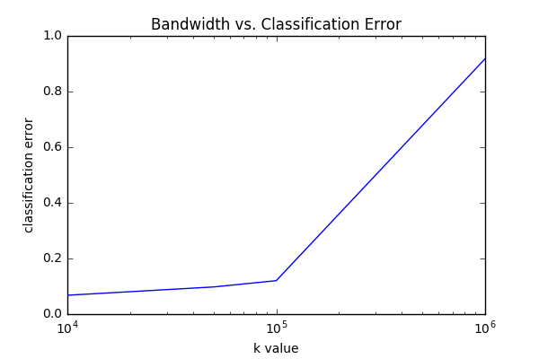
Our K-Nearest Neighbors
Like the baseline we found, through cross validation, that a k of 1 to be best for our k-NN regression. For kernel regression, we found a bandwidth of 10^4 was best for our Nadaraya-Watson Gaussian kernel regression. Let's find out our test error with a model that is 1/4 of the training set for both algorithms.

Slide 9
Our SVM
Standard linear SVM
Trained with stochastic gradient descent
Tuned hyper-parameters with cross validation
PEGASOS
Tuned hyper-parameters with cross validation
RBF kernel approximation with Random Fourier Features
Similar to what we found in the baseline, the RBF kernel hurts performance a lot

Slide 10
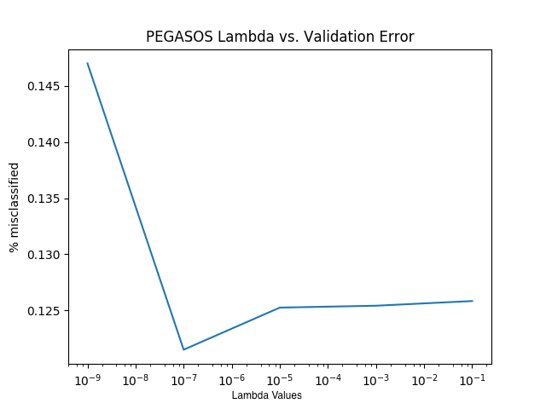
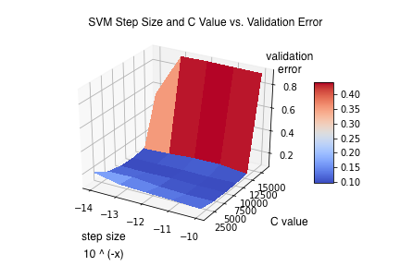
Our SVM

Slide 11
Our Convolutional Neural Network
Implemented using TensorFlow
Two convolutional layers, one densely connected layer
Uses ReLU and dropout

Slide 12
Results
KNN
 | 1-NN | Kernelized 1-NN | SciKit 1-NN
Test Error | 4.5% | 4.7% | 3.1%
SVM
 | SGD | PEGASOS | PEGASOS + RFF | SciKit Linear | SciKit RBF
Test Error | 10% | 9% | 88% | 15% | 89%
CNN: 0.08% Test Error

Slide 13
Concluding Notes
Because of runtime constraints, we limited the model size of:
Our K-NN implementation
Gaussian kernel was especially difficult to deal with in terms of runtime
Baseline SVM runtime is intractable
Convergence condition seemed difficult to meet, hence training on the entire dataset was infeasible
As a result:
Our K-NN had a higher error than the library implementation
SciKit SVMs had higher error than our implementations
Surprising:
SVM with a RBF kernel did significantly worse than linear SVM
Investigate how Maji and Malik [2] utilized the RBF kernel

Slide 14
References
[1] LeCun, Yann, et al. "Comparison of learning algorithms for handwritten digit recognition." International conference on artificial neural networks. Vol. 60. 1995.
[2] Maji, Subhransu, and Jitendra Malik. "Fast and accurate digit classification." EECS Department, University of California, Berkeley, Tech. Rep. UCB/EECS-2009-159 (2009).
[3] Sundaresan, Vishnu, and Jasper Lin. "Recognizing Handwritten Digits and Characters." (1998).

Slide 15
Test Error

Slide 16
For Deric:
Library K-NN: 0.0309
Our KNN: 0.045
Library SVM RBF: 0.8865
Library SVM Linear: 0.1471

